Slide 1
Inventory Model Simulation in C Chapter#1(1.5.3 and 1.5.4)
Presented by Group 13
Mehak Fatima(B21110006057)
Rimsha Laraib(B21110006107)
Yumna Mubeen (B21110006165)
Tahrim Bilal(B21110006153)

Slide 2
1.5.3
C-PROGRAM

Slide 3
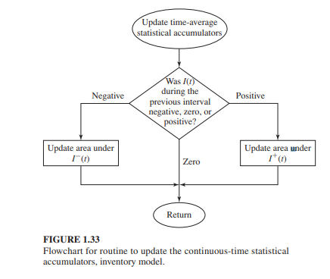
Objectives
This project simulates a single-product
inventory system to explore various
inventory policies.
It uses a C program to handle inventory
and demand events over time and evaluate
policy effectiveness based on cost.
The aim is to determine optimal
Inventory policies for cost efficiency.

Slide 4
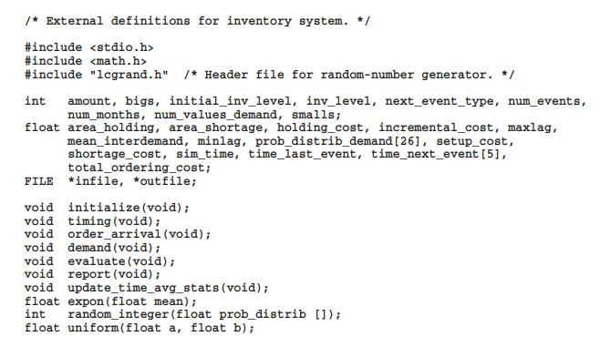
External Definitions for Inventory system
External definitions set up core variables and arrays used throughout the simulation.
Variables: These include inventory levels, cost variables, arrays for probability distributions, and simulation control variables.
Array: time_next_event[5] used to keep track of scheduled times for each event in the simulation and prob_distrib_demand[26] which holds cumulative probabilities for different demand sizes. This lets us simulate random demand accurately.
Functions: The functions handle initialization, event processing, demand simulation, and reporting
We also include lcgrand.h for random number generation.

Slide 5
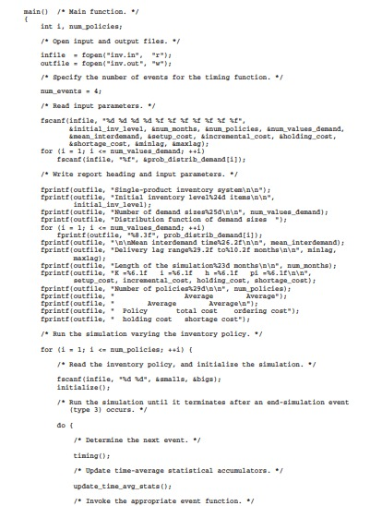
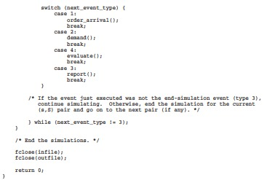
Main Function
Purpose
The main function manages the entire simulation process, acting as the control center.
Key Steps:
We start by opening input and output files, then read parameters that set up our simulation.
The loop iterates through (s, S) policies, updating inventory, generating demand, and calculating costs for each policy.
The do-while loop ensures the simulation runs until the end event is triggered.
Control Structure:
A for loop iterates through each inventory policy, and a do-while loop keeps the simulation running as long as events occur.

Slide 6
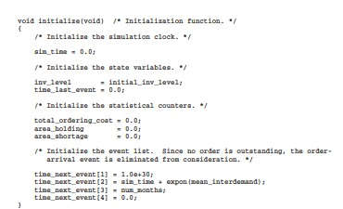
Initialization Function
Purpose:
The initialization function prepares the simulation environment.
Components:
Sets up starting inventory and timing variables.
Resets statistical counters that track costs and time-related variables.
Initializes the event list, marking future events. The time_next_event array schedules the first demand and inventory evaluation events.
Example:
The inventory evaluation is scheduled at time 0 because the initial inventory might be less than our reorder point (s).

Slide 7
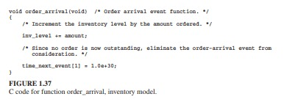
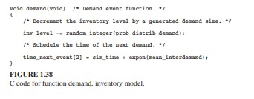
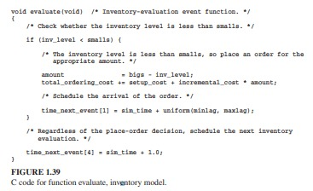
Event Functions
Key Events:
Order Arrival:
"This function updates the inventory when an order arrives. It increases inv_level based on the order size."
"Once an order is received, we remove it from future events."
Demand:
"This function adjusts inventory by subtracting a randomly generated demand size, modeling customer purchases or demand."
"Schedules the next demand event using an exponential distribution."
Evaluate:
"Checks if inventory is below the reorder point (smalls). If so, places an order to replenish stock up to bigs level."
Switch Statement:
"These events are managed by a switch statement in main() that triggers the right function based on event type."

Slide 8
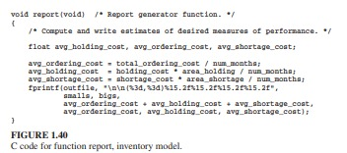
Reporting Function
Purpose:
The reporting function generates an output summarizing the costs associated with each inventory policy.
Details Captured:
The report includes average ordering cost, holding cost, and shortage cost, as well as the total cost per policy.
This output helps compare policies and select the most cost-effective approach.
Output Format:
Each (s, S) pair is recorded along with its performance metrics, showing how changing policies impact costs.

Slide 9
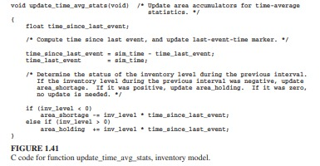
Statistical Updates
Function: update_time_avg_stats
Mechanism:
This function calculates and updates time-average statistics. It determines whether the inventory was high or low, adding to holding or shortage areas.
If inventory was negative (shortage), it adds to area_shortage. If positive, it updates area_holding.
Use Case:
These calculations help us determine costs accurately based on how long inventory remains high or low.

Slide 10
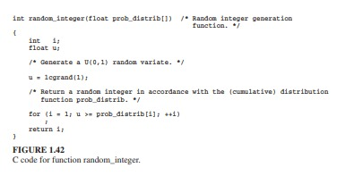

Random Number Generation
Functions:
Random_integer:
This function generates a random integer demand based on cumulative probabilities in prob_distrib.
Ensures demand variation matches expected probabilities.
Uniform:
Generates a uniform random variable between two values, used for timing events.
For example, it helps decide when an order will arrive after it’s placed.
Purpose:
These functions simulate demand and event timing realistically, making the simulation more accurate.

Slide 11
1.5.4
SIMULATION OUTPUT AND DISCUSSION

Slide 12
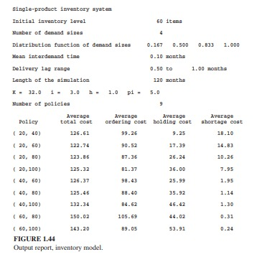
Simulation Output
Output File: inv.out
Insights:
The simulation produces data on ordering, holding, and shortage costs for each inventory policy.
These outputs reveal how costs respond to different policies, such as increasing S while keeping s fixed.
Example:
For instance, the policy (20, 60) produced an average cost of $122.74/month, suggesting it may be the most cost-effective option.

Slide 13
Discussion & Analysis
The simulation results show how changes in inventory policy parameters ( s ) (reorder point) and ( S ) (order-up-to level) impact holding, ordering, and shortage costs. For example, increasing ( S ) raises holding costs but lowers shortage and ordering costs, while raising ( s ) reduces shortage costs but increases holding costs. The (20, 60) policy achieved the lowest average total cost of $122.74 per month. However, to ensure accuracy, multiple simulation runs are advised due to potential variability in results with different random values.

Slide 14
Conclusion
Summary:
In summary, this C program provides a way to test different inventory policies and understand their cost implications.
It gives insight into balancing order size and frequency for cost-efficient inventory management.
Future Work:
Future steps could involve exploring additional policies or increasing the simulation runs to improve accuracy.

Slide 15
Thank You

